Slide 1
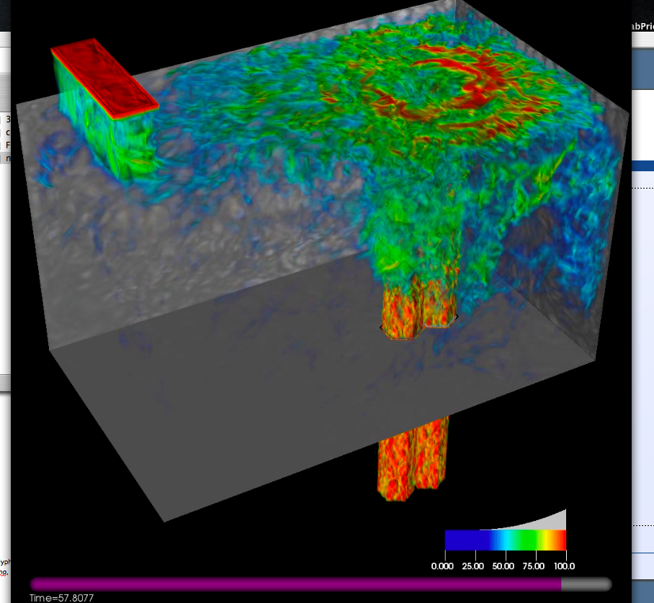
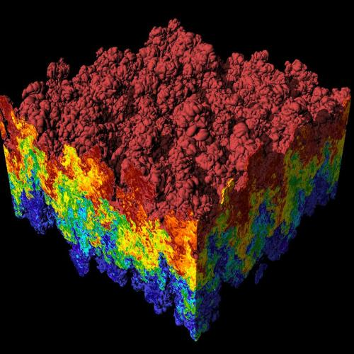
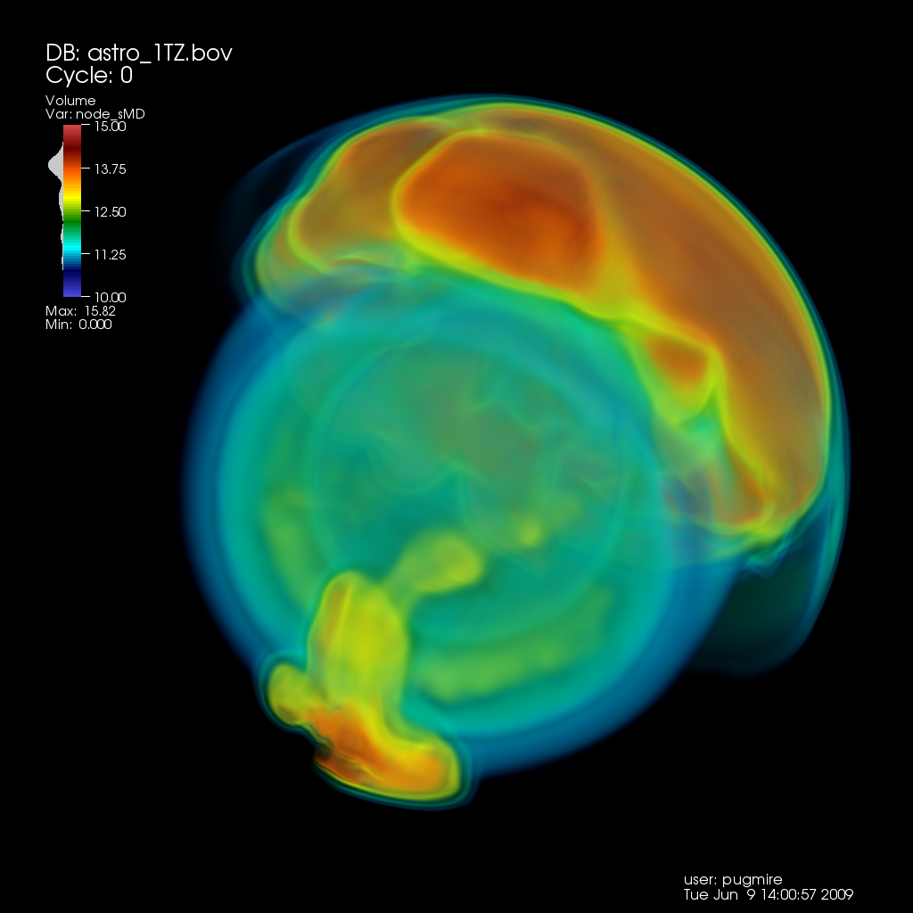
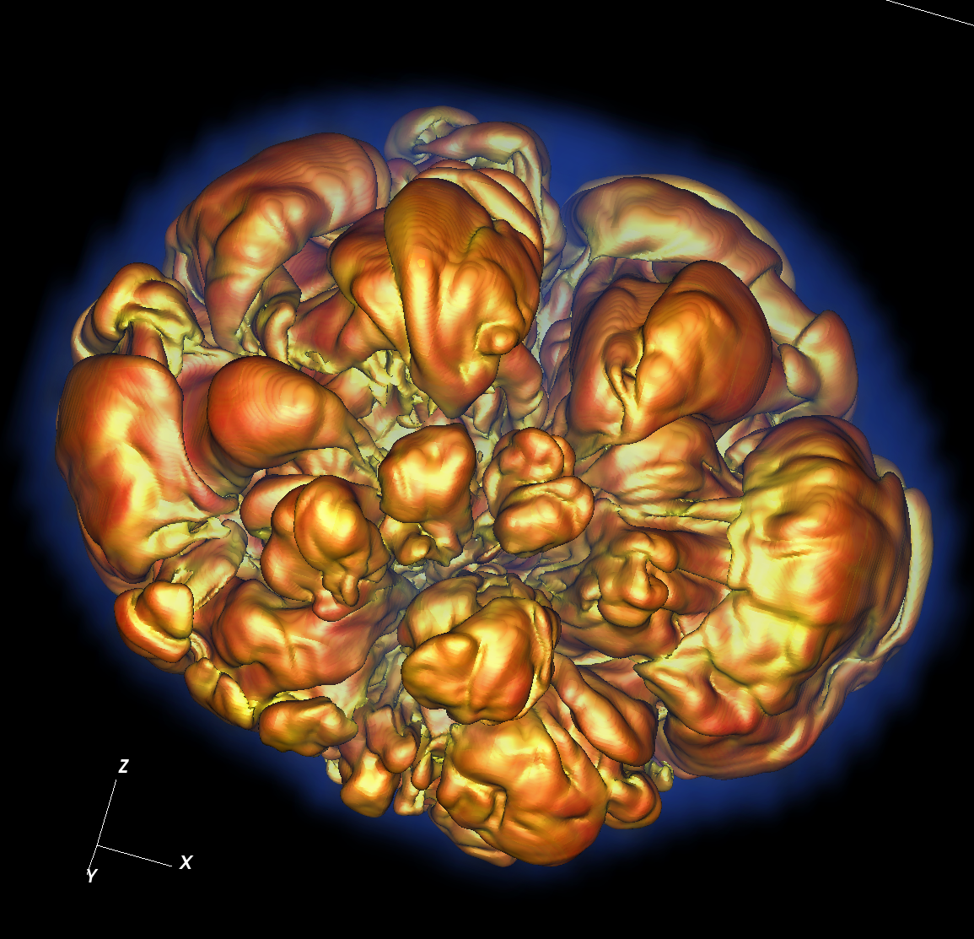
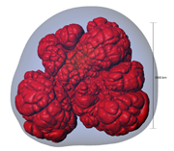
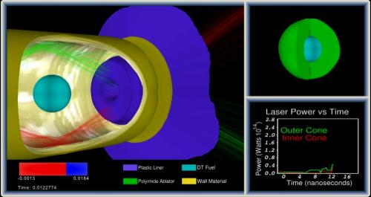
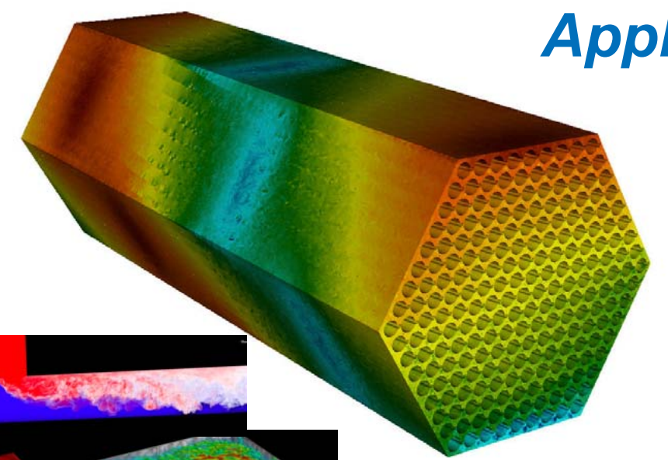
CIS 441/541: Introduction to Computer Graphics
January 8, 2019
Hank Childs, University of Oregon

Slide 2

Hi, I’m Hank…
Associate Professor of CIS at UO
Arrived at UO March 2013
Research interests include visualization, high-performance computing, computer graphics
Director of CDUX Research Group (10 PhD, 0 MS, 3 BS)

Slide 3
My Background
Previously:
Lawrence Livermore, 1999-2009
Lawrence Berkeley, 2009-2016
UC Davis 2009-2013
Education:
B.S. (CS/Math), 1994-1999
Ph.D., 2000-2006
I have spent 15 years programming,
almost exclusively using C, C++, and Unix
Notes:
Two takeaways: Unix/C/C++ very important, plus I know a lot about it

Slide 4
Trying to Add the Class?
Let’s talk after class…

Slide 5
Outline
What is Computer Graphics?
Class Overview (Syllabus)
Project 1A Overview

Slide 6
Outline
What is Computer Graphics?
Class Overview (Syllabus)
Project 1A Overview

Slide 7
Computer Graphics
Defined: pictorial computer output produced, through the use of software, on a display screen, plotter, or printer.

Slide 8
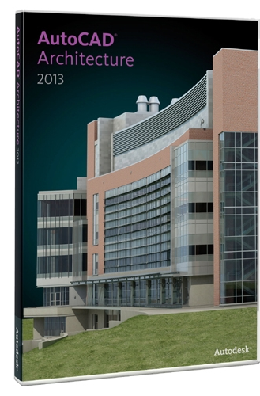
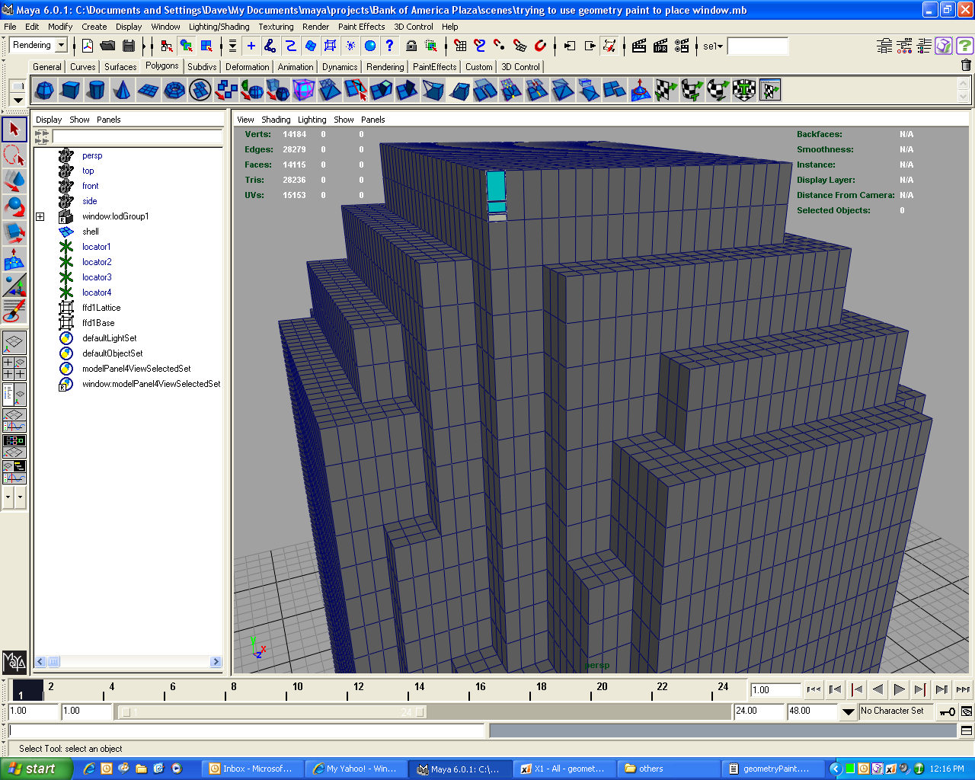
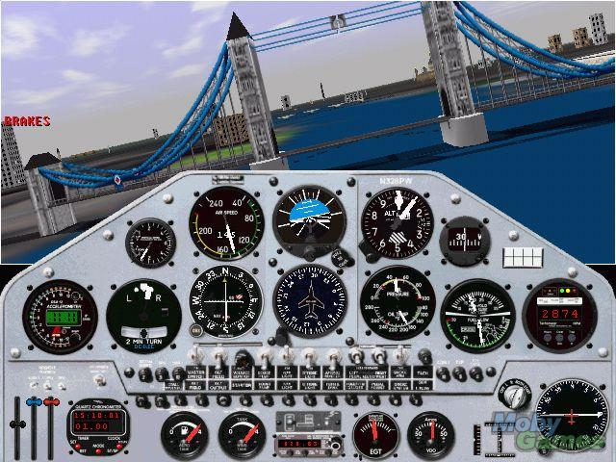
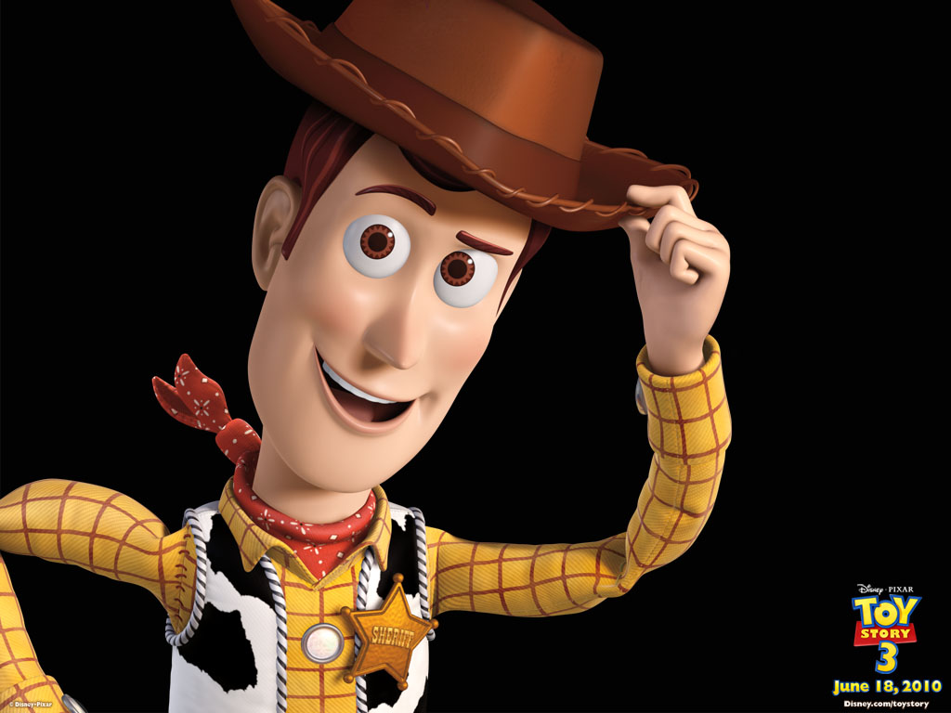
What is computer graphics good for?
Ed Angel book:
Display of information
Design
Simulation and animation
User interfaces

Slide 9
What are the challenges?
How do you transform geometric primitives to images?
→ We will focus on the “rasterization” method, which is what specialized hardware (GPUs) use
The next lecture will give an overview of rasterization
In the coming weeks, we will learn how to transform the geometry so it can be rendered, which will require linear algebraic techniques
→ In the latter part of the course, I will give an overview of an alternate method, called ray tracing

Slide 10
What are the challenges?
How do you do it quickly?
→ we will explore optimizations, including
Texture Mapping
Clipping
Advanced data structures for geometry organization
→ we will learn how to use the GPU to accelerate rendering, through the OpenGL (?) interface

Slide 11
What are the challenges?
How do you make it pretty?
→ we will explore different shading models
→ we will learn how to control light sources
→ in the latter part of the course, I will discuss how to use transparency
→ in the latter part of the course, I will discuss how to add shadows

Slide 12
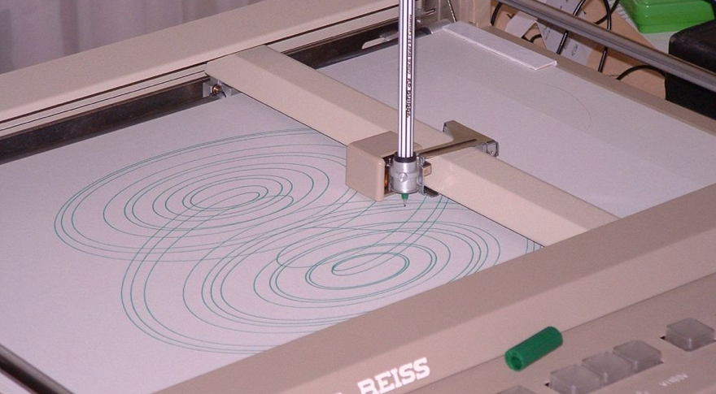
We are starting this class off “old school.”
Drum Plotter, which follows “Pen-Plotter Model”

Slide 13
We are starting this class off “old school.”
Pen-Plotter Model has two commands:
Moveto(x, y)
Lineto(x, y)
Example:
Moveto(0,0)
Lineto(1,0)
Lineto(1,1)
Lineto(0,1)
Lineto(0,0)

Slide 14
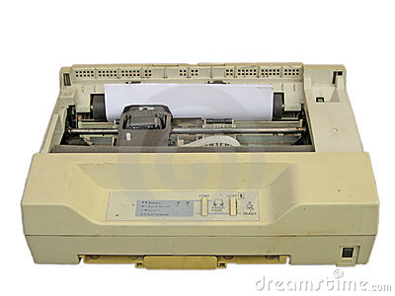
We are starting this class off “old school.”
Dot Matrix Printer

Slide 15
We are starting this class off “old school.”
We will start by setting the colors for individual pixels in an image.
Then we will learn how to take geometries in specific orientations and render them (think dot matrix printer).
Then we will learn how to take geometries in any orientation and render them. (i.e., arbitrary camera locations)
Then we will learn how to program a GPU to do all this in hardware.
Then we will do cool things.

Slide 16
Outline
What is Computer Graphics?
Class Overview (Syllabus)
Project 1A Overview

Slide 17
Syllabus
All syllabus information is located online at:
https://www.cs.uoregon.edu/Classes/19W/cis441/

Slide 18
Expectations
This is a projects-driven class. The projects will help you learn the theory of computer graphics, but they will also help you become better programmers, and provide you with experiences, anecdotes, and images that will impress potential employers.
The grading is designed to make sure you are keeping up with the assignments. Staying on top of the projects will be critical to succeeding in this class.

Slide 19
Expectations
The projects in this class will be hard work. It is difficult to quote exactly how much time, since there is variation in background and programming skill. I expect those who have less developed programming skills will find this class to be a considerable effort, but also that they will have significant improvement by the end of the course.

Slide 20
Norms for this class
Please ask questions
Please ask me to slow down
Please give feedback
You are welcome to call me “Hank”

Slide 21
This Class In a Nutshell…
1st Half: Learn the theory behind computer graphics and implement it in software
Middle: Learn OpenGL (?) and write an OpenGL program
End: Design and implement a final project
Final: present final project. (Midterm a few weeks earlier)
Most of the learning will happen with projects. The lectures are designed to help you do the projects.

Slide 22
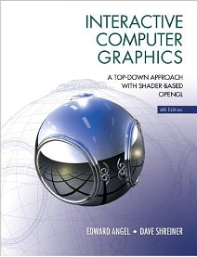
Course Materials
I recommend the Ed Angel book, but it is not required and students who comprehend the lectures will not need it.
We will also use the graphics notes from Ken Joy.
PowerPoint lectures will be posted online.
Some lectures will be chalkboard.

Slide 23
Grading
Project 1: 30 points
Project G (grad students): 15 points
Project 2: 15 points
Proposal for Project 3: 0 points
Midterm: 25 points
Project 3: 30 points

Slide 24
Project 1 (30): Implement graphics algorithms in Software
Project 1A (due Jan 12th): Install and run example program (2%)
Project 1B (due Jan ~15): Rasterize screen-space triangles (7%)
Project 1C (due Jan ~21): Rasterize colored triangles (2%)
Project 1D (due Jan ~26): Add Gouraud shading (4%)
Project 1E (due Feb ~2): Add Phong shading (7%)
Project 1F (due Feb ~8): Add world-space-to-camera-space transforms (8%)
These projects build on one another.
If you do not do these projects in a timely way, you will likely not pass the class.

Slide 25
Projects 2, 3, and midterm
Project G: 15%
Project 2: 15%
Project 2A (due Feb ~15th): Basic OpenGL program (8%)
Project 2B (due Feb ~22nd): Advanced OpenGL program (7%)
Midterm (Feb ~26): 25%
Final Project Proposal (due Feb ~26): 0%
Project 3: 30%
Student-defined projects due on Finals week (30%)
This class: Monday March 18th, 8am

Slide 26
Final Project Ideas
Make a video game
Make a screen saver
Do some advanced graphics techniques
Model Deschutes
Etc…

Slide 27
Grading
Projects 1A-1F, 2A, and 2B will be submitted to Canvas and graded by me or the TA. In almost all circumstances, producing the correct picture will result in full credit.
Even slightly wrong? → Less than half credit
The final projects will be demonstrated in front of the whole class on the day of the Final. Since we have such a large class, we may need to be creative on how to do this (i.e., multiple rounds with subsets of us, culminating in a finale during the Finals period).

Slide 28
Grading
Project 1: 30 points
Project G: 15 points
Project 2: 15 points
Proposal for Project 3: 0 points
Midterm: 25 points
Project 3: 30 points
➔ 100 points
denominator for 541: 115:
541 students expected to get 30 on Project 3, participate in Project G

Slide 29
Midterm
25 points
NOT: A = 22.5, B = 20, C = 17.5, etc…
INSTEAD:
A students typically score >20 points
B students typically score >15 points
…

Slide 30
Final Project
Most final projects score 25/30
Exceptional projects get 30/30

Slide 31
In All…
I am happy to give everyone A’s
But:
If you want to get an A, you should be aiming for perfect scores on 1A-1F, 2A, 2B
Since most people will lose points on the midterm and final project
20/25 on midterm, 25/30 on final project, and perfect scores on 1A-1F, 2A, 2B will earn you an A.

Slide 32
Office Hours
Only come to OH if you have started the project
Sit and listen to others questions is not an option
Surge OH this week to help with 1A, 1B
Thursday, Friday
When should regular OH be?

Slide 33
Academic Misconduct (1 of 2)
The programming projects are individual efforts
You may discuss the projects with your classmates.
Do not let someone look at your code on your screen. (BUT: helper can look at helpee’s code)
Absolutely, positively do not email code.
Do not search the internet for previous implementations (includes github)

Slide 34
Academic Misconduct (2 of 2)
If I detect collusion, all individuals involved will receive an F in the course immediately
I choose to not enumerate cases that involve collusion. Whiteboard conversations are fine. If appropriate, the helper can look at the helpee’s code. If you feel you are in a gray area, then you should email me.
Please note that if you are the one providing too much help, then you will also get an F

Slide 35
Working Together
All projects are individual projects.
Copying code from other students is cheating.
However: I highly encourage you to discuss your roadblocks with each other and lean on each other to figure out solutions to your problems.

Slide 36
Working Together, part 2
Piazza
I encourage you all to monitor (and respond) to the forum.
I may award extra credit to students who are particularly helpful on the forum.
The amount of credit will vary based on involvement, with a maximum of 1/3rd grade (i.e., B to B+).

Slide 37
Evaluation Criteria
For Project 1, I will provide some test configurations. I will also provide the correct images and share them with you.
If your program produces the correct images, you are very likely to receive full credit.
For Project 2, you evaluation is to be determined
For Project 3, you will be evaluated on the results of your project, including how ambitious your undertaking is.
We will jointly establish if you are embarking on a project where you will be able to earn the full 30% when we discuss your Final Project Proposal during Week 7.

Slide 38
Late Passes
You have 2 "late passes."
Late passes allow you to turn in your project two days after the due date for full credit.
If you run out of late passes, then you may continue to earn half credit on any project.
Every unused late pass is worth 0% extra credit.
Don’t need to tell me if you want to use it
Late pass assignment will be a question on the final
All late projects will be scored at 50% and then credit from late passes will be awarded at the end of the term

Slide 39
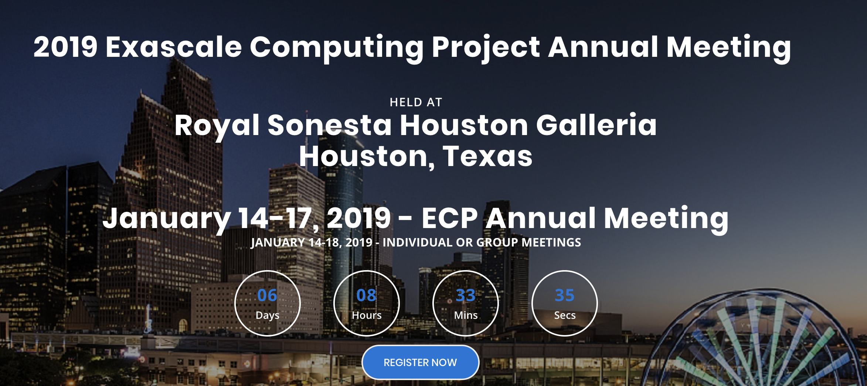


Planned Absences
Schedule TBD for absences

Slide 40
Class Summary
This class will teach you the theory of computer graphics
This class will improve your programming skills
This class may help you land a job
This class will require a lot of work

Slide 41
Outline
What is Computer Graphics?
Class Overview (Syllabus)
Project 1A Overview

Slide 42
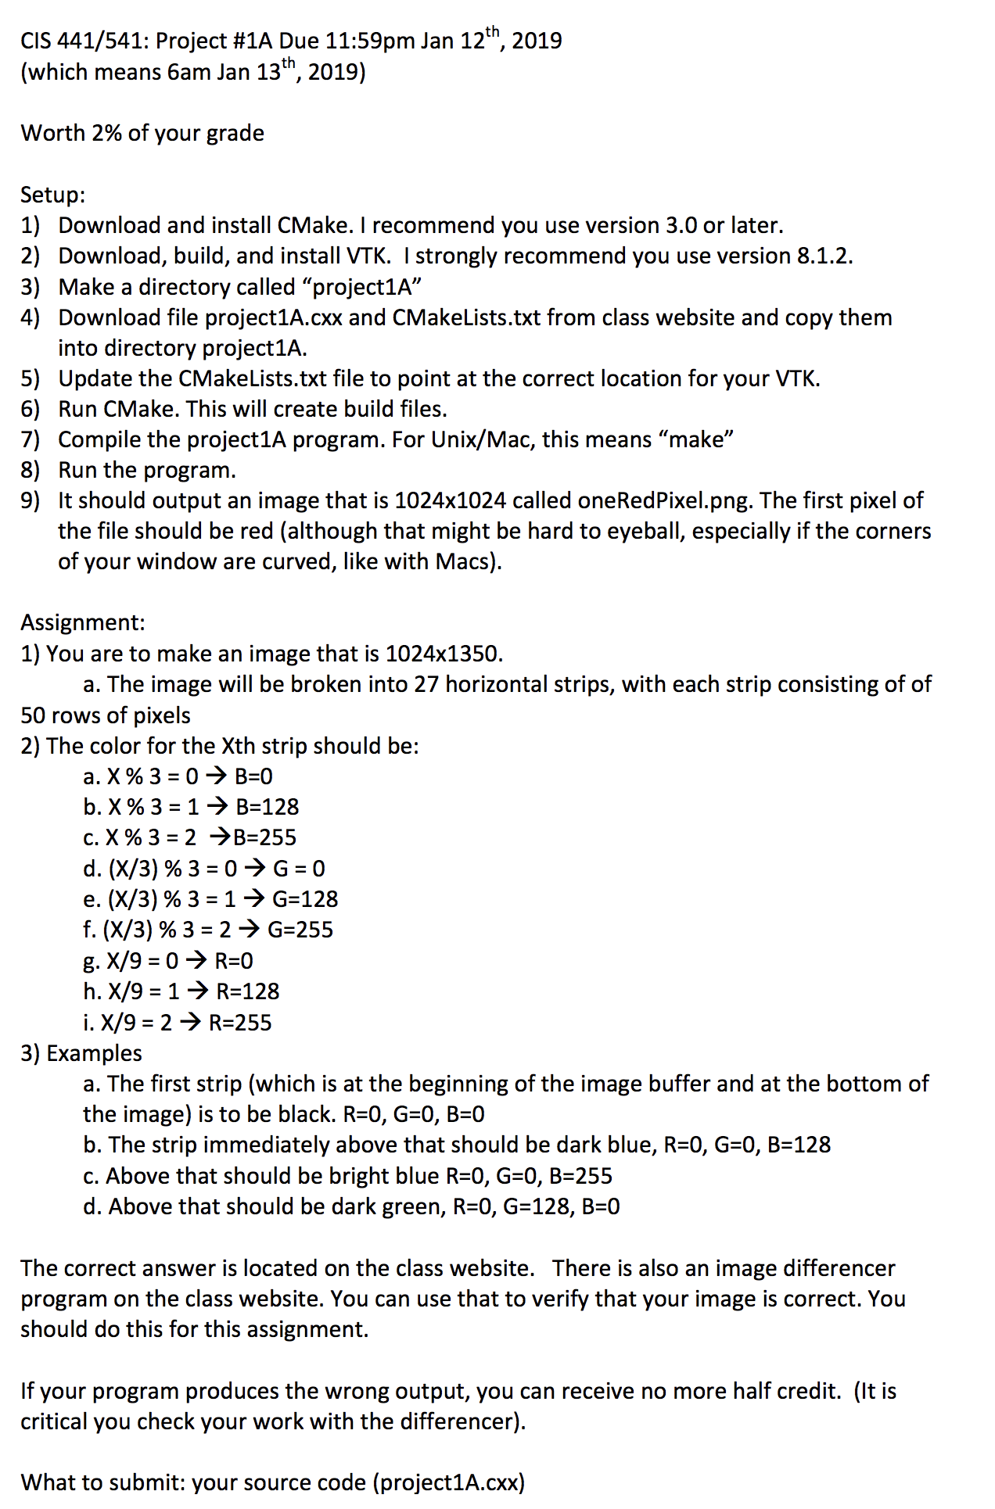
Project #1A
Goal: write a specific image
Due: 11:59pm, Jan 12th … in 84 hours (!)
% of grade: 2%
Q: Why do I only get 4 1/2 days to complete this project?
A: We need to need to get multi-platform issues shaken out ASAP.
May be a little painful
And: 1B is coming soon after…

Slide 43
Project #1A: background
Definitions:
Image: 2D array of pixels
Pixel: A minute area of illumination on a display screen, one of many from which an image is composed.
Pixels are made up of three colors: Red, Green, Blue (RGB)
Amount of each color scored from 0 to 1
100% Red + 100% Green + 0% Blue = Yellow
100% Red + 0% Green + 100 %Blue = Purple
0% Red + 100% Green + 0% Blue = Cyan
100% Red + 100% Blue + 100% Green = White

Slide 44
Project #1A: background
Colors are 0->1, but how much resolution is needed? How many bits should you use to represent the color?
Can your eye tell the difference between 8 bits and 32 bits?
→ No. Human eye can distinguish ~10M colors.
8bits * 3 colors = 24 bits = ~16M colors.
Red = (255,0,0)
Green = (0,255,0)
Blue = (0,0,255)

Slide 45
Project #1A: background
An “M by N” 8 bit image consists of MxNx3 bytes.
It is stored as:
P0/R, P0/G, P0/B, P1/R, P1/G, P1/B, … P(MxN)/R, P(MxN)/G, P(MxN)/B
P0 is the bottom, left pixel
P(M-1) is the bottom, right pixel
P((MxN)-M+1) is the top, left pixel
P(MxN) is the top, right pixel

Slide 46
Project #1A: background
The red contributions are called the “red channel”.
Ditto blue & green.
There are 3 channels in the image described above.
There is sometimes a fourth channel, called “alpha”
It is used for transparency.
→ Images are either RGB or RGBA

Slide 47
Project #1A in a nutshell
Assignment:
Install CMake
Install VTK
Modify template program to output specific image

Slide 48

What is ?
Cmake is a cross-platform, open-source build system.
CMake is a family of tools designed to build, test and package software.
CMake is used to control the software compilation process using simple platform and compiler independent configuration files.
CMake generates native makefiles and workspaces that can be used in the compiler environment of your choice.

Slide 49
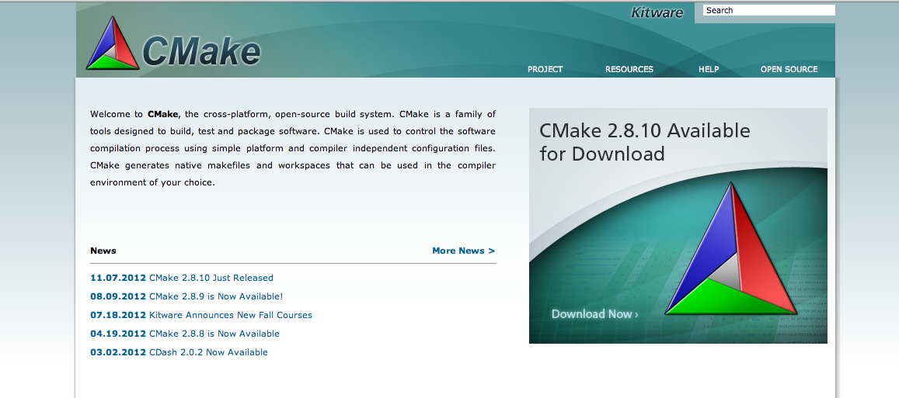
How do you install CMake?
Go to www.cmake.org & follow the directions

Slide 50

What is the ?
The Visualization Toolkit (VTK) is an open-source, freely available software system for 3D computer graphics, image processing and visualization.
VTK consists of a C++ class library and several interpreted interface layers including Tcl/Tk, Java, and Python.
VTK is cross-platform and runs on Linux, Windows, Mac and Unix platforms.

Slide 51
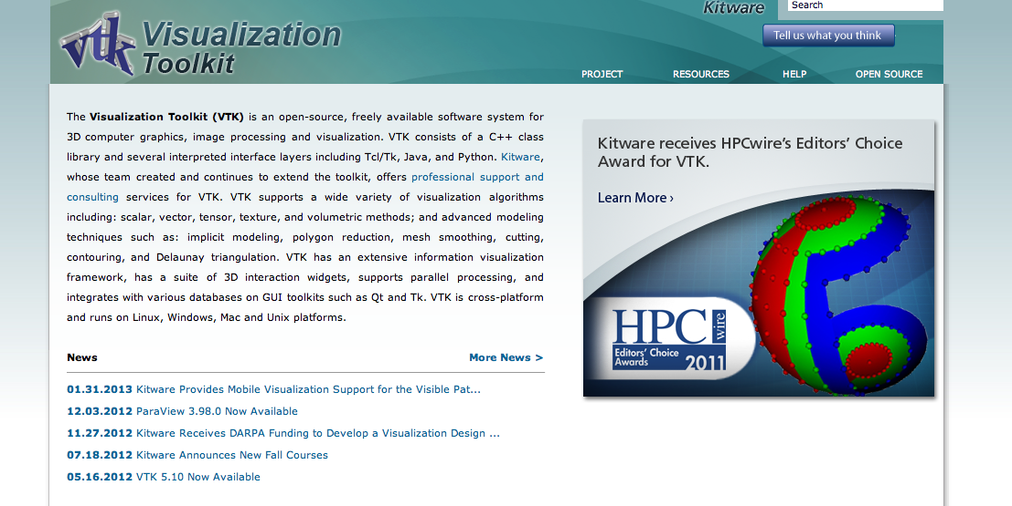
How do you install VTK?
Go to www.vtk.org , go to Resources->Download and follow the directions

Slide 52

What is the image I’m supposed to make?
(255,255,255)
R=255
(255, 0, 0)
(128,255,255)
R=128
(128,0,128)
(128, 0, 0)
(0,255,255)
(0, 255, 128)
(0, 255, 0)
(0,128,255)
R=0
(0,128,128)
(0,128,0)
(0,0,255)
(0,0,128)
(0,0,0)

Slide 53
What do I do again?
Install CMake & VTK.
Download “project1A.cxx” from class website
Download “CMakeLists.txt” from class website
Run CMake
Modify project1A.cxx to complete the assignment
Run differencer!
Less than half credit if it does not pass differencer
Upload project1A.cxx to Canvas

Slide 54
What should you do if you run into trouble?
Start with Piazza (?)
Surge OH this week
Don’t forget: this lecture is available online

